Slide 1
Provide Insights to the Product Strategy Team in the Banking Domain
RPC #8

Slide 2
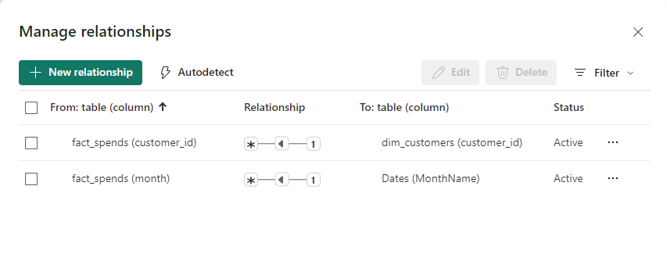
Data Modeling - Relationships

Slide 3
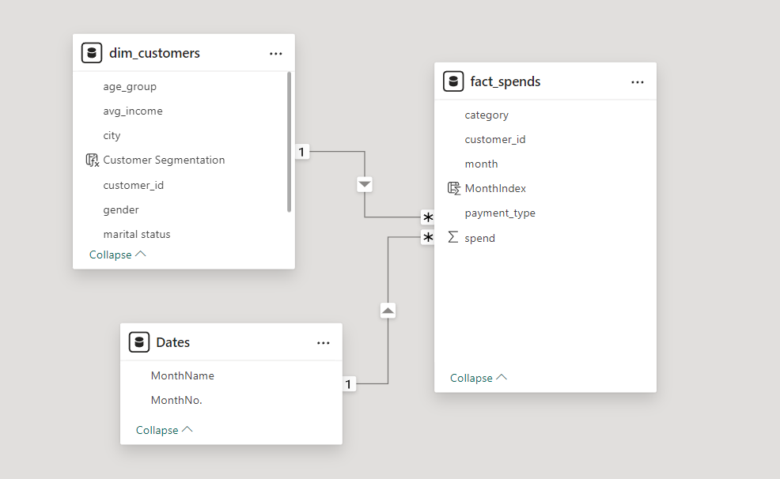
Data Modeling

Slide 4


Report
Live Report

